Slide 1
🤔
What is the shirt you are wearing made of?
Notes:
https://www.improvemag.ch/change/fast-fashion-fakten/1475/
https://www.sustainyourstyle.org/old-working-conditions

Slide 2


🤯
Un-fashionable Facts
20%
Clothes disposed within less than 1 year after production
of global water pollution is caused by the textile industry
60%
14-16 hours / day
7 days / week
average working conditions in most garment manufacturing countries
Sources:
https://www.improvemag.ch/change/fast-fashion-fakten/1475/
https://www.sustainyourstyle.org/old-working-conditions
Notes:
https://www.improvemag.ch/change/fast-fashion-fakten/1475/
https://www.sustainyourstyle.org/old-working-conditions

Slide 3

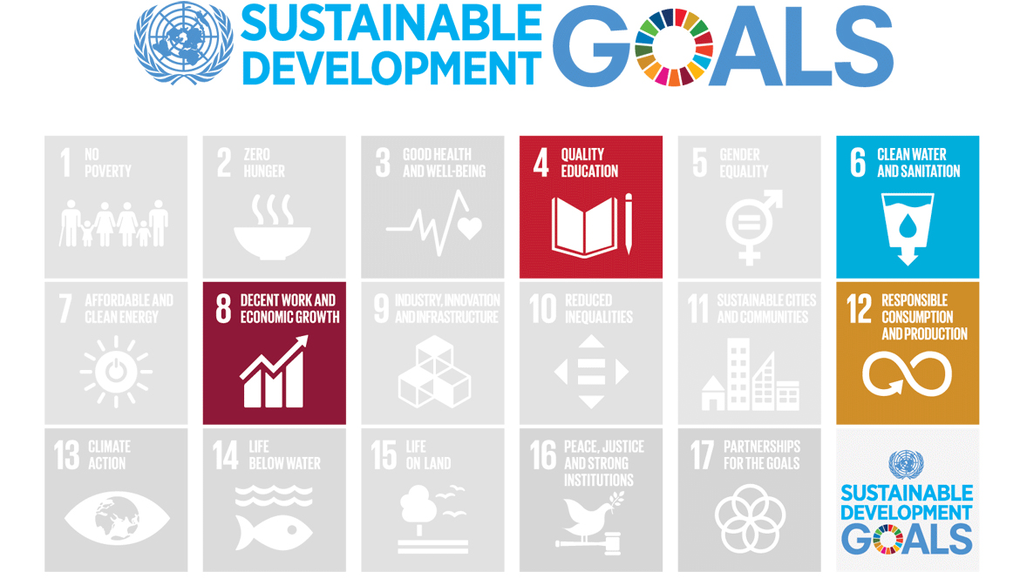

Slide 4



Mission
Leverage technology to motivate people to be more conscious about clothes.
Education
Promotion
Community
Educate people about sustainability and ethics in the fashion industry
Promote brands/shops/initiatives that support upcycling, reuse, sustainability and fair working conditions
Do challenges with the online community or your friends
Notes:
https://www.improvemag.ch/change/fast-fashion-fakten/1475/
https://www.sustainyourstyle.org/old-working-conditions

Slide 5

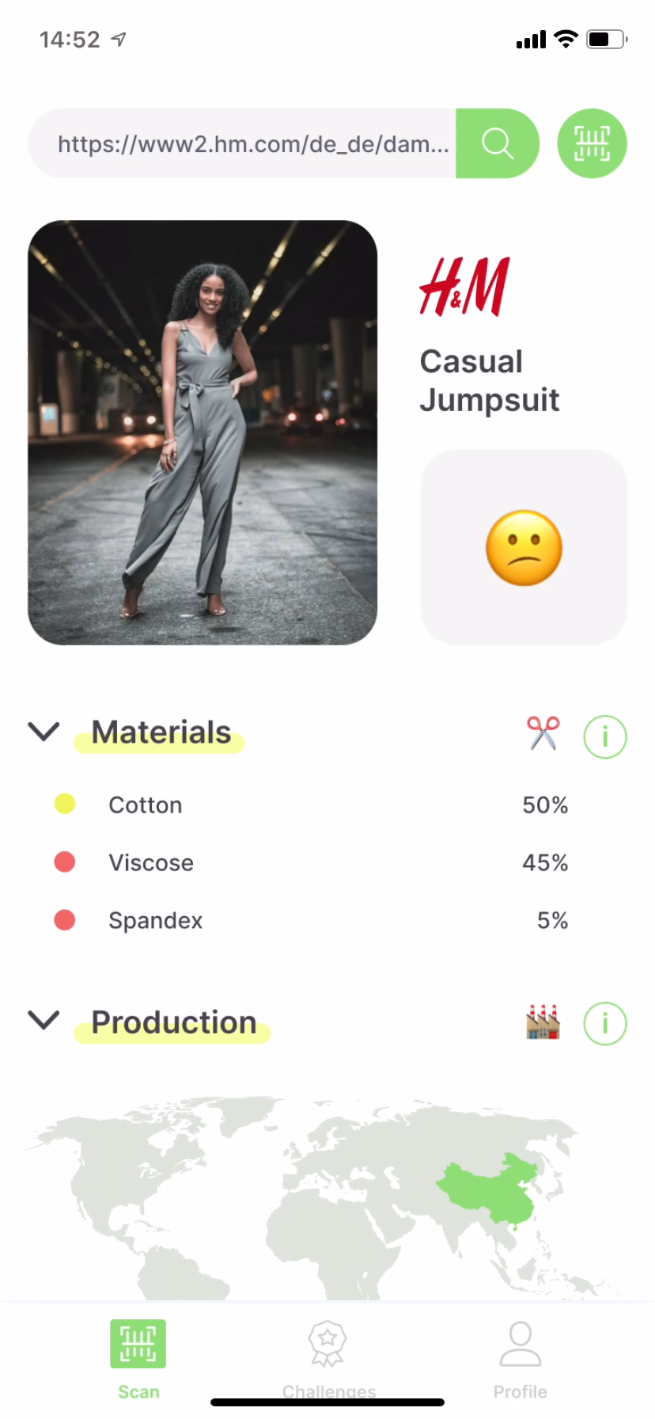
The Fashion Conscience
Alexandra Studer, Isa Simo, Ming Zheng, Callum Maguire
Notes:
https://www.improvemag.ch/change/fast-fashion-fakten/1475/
https://www.sustainyourstyle.org/old-working-conditions

Slide 6
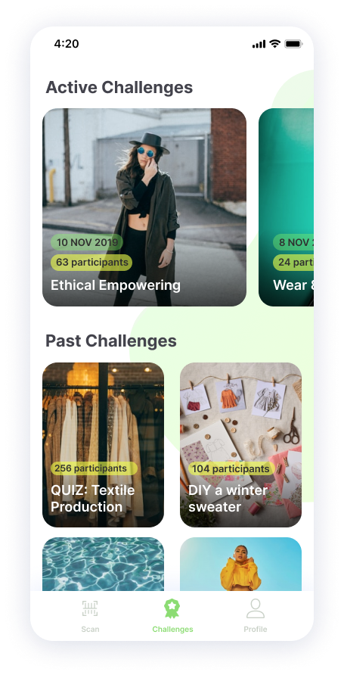
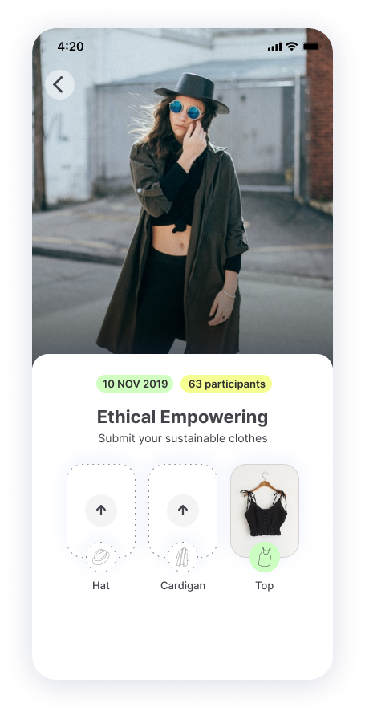
The Fashion Conscience
Alexandra Studer, Isa Simo, Ming Zheng, Callum Maguire
Notes:
https://www.improvemag.ch/change/fast-fashion-fakten/1475/
https://www.sustainyourstyle.org/old-working-conditions

Slide 7
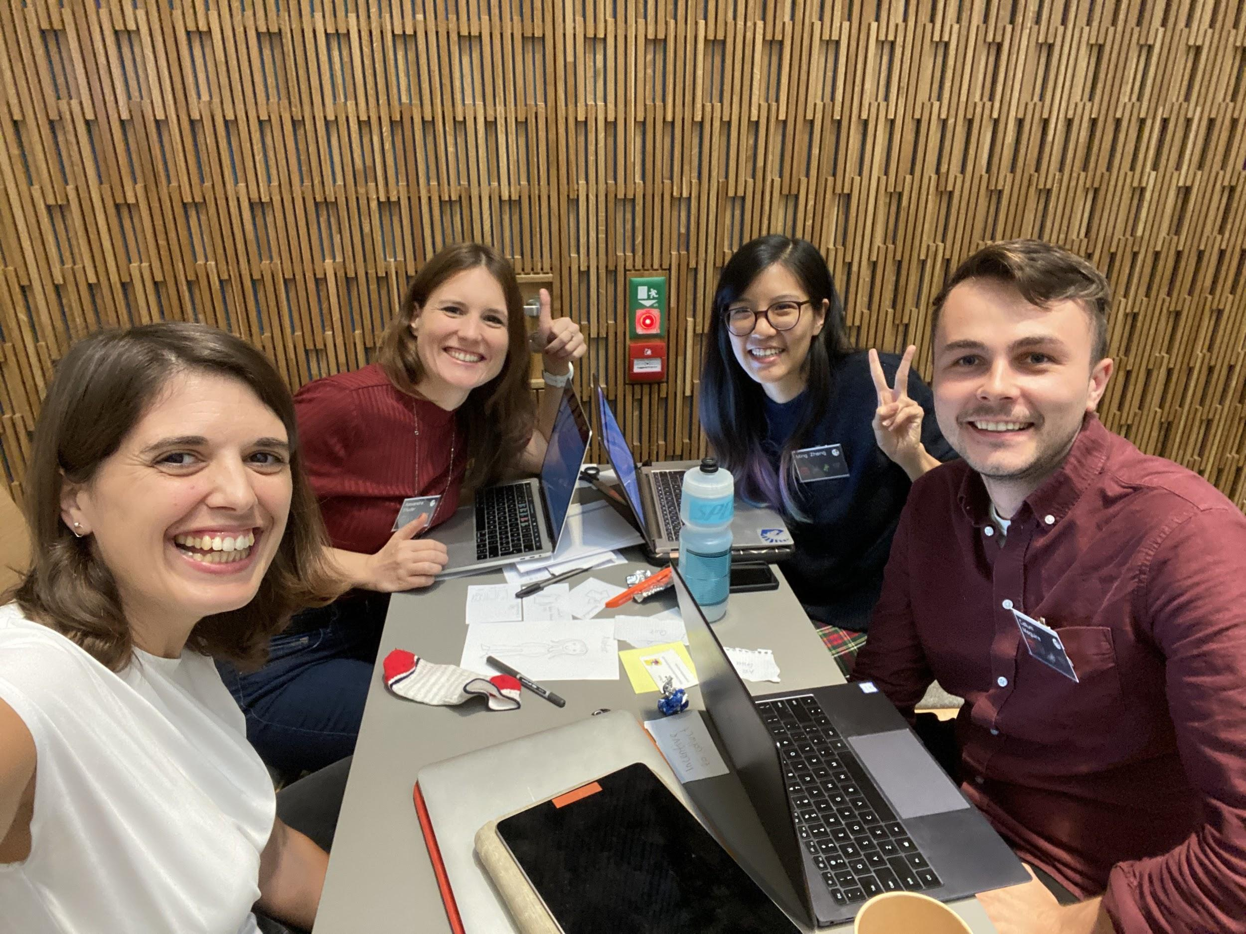
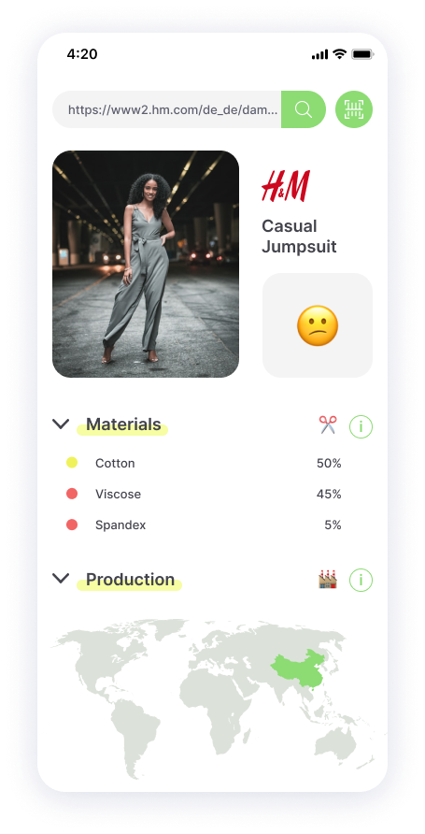
😎
The Awesome Team
Alexandra Studer, Isa Simo, Ming Zheng, Callum Maguire (1day only)
Notes:
https://www.improvemag.ch/change/fast-fashion-fakten/1475/
https://www.sustainyourstyle.org/old-working-conditions

